Slide 1
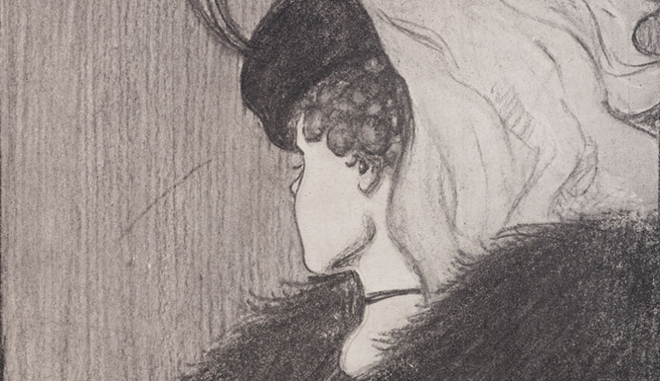
Do you see an
Old Woman,
Or a Young Lady?

Slide 2
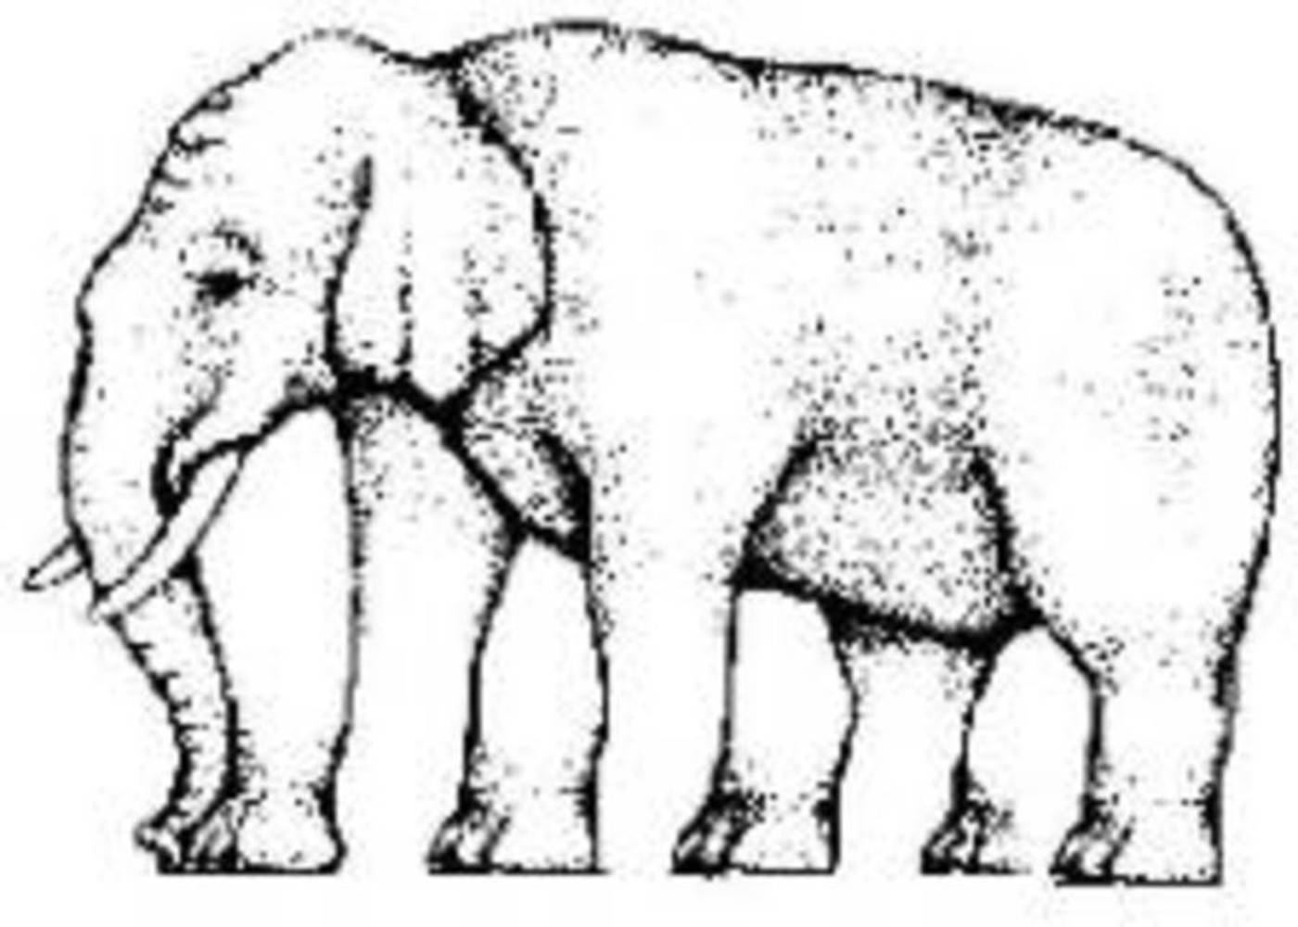
How Many Legs does the Elephant have?

Slide 3
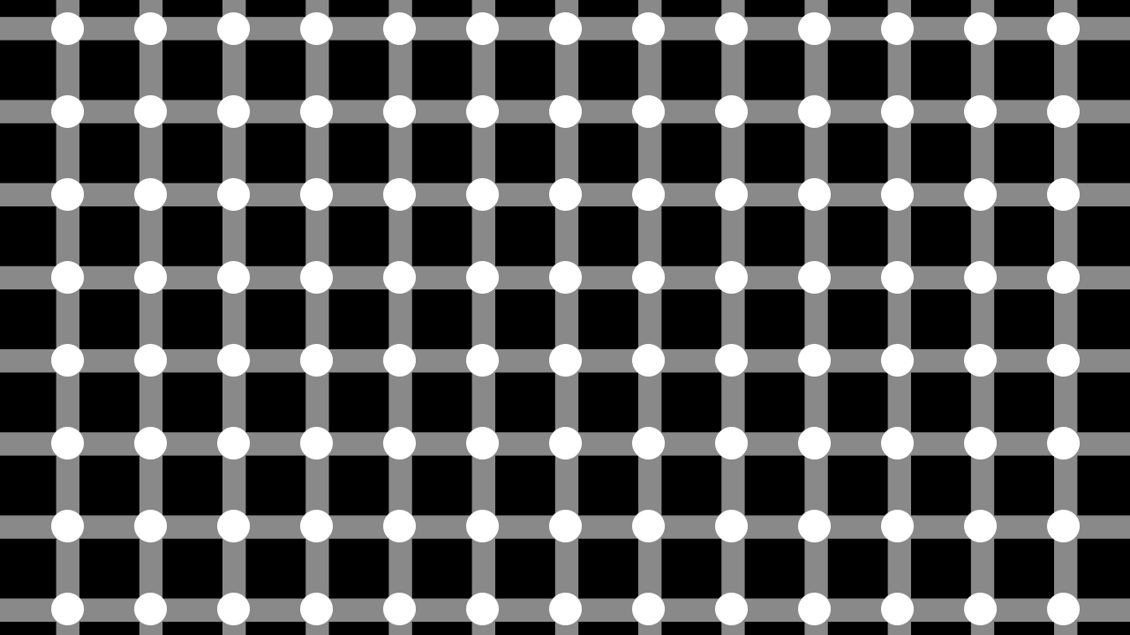
How many black dots?

Slide 4


Is Rectangle the same colour at both ends?

Slide 5
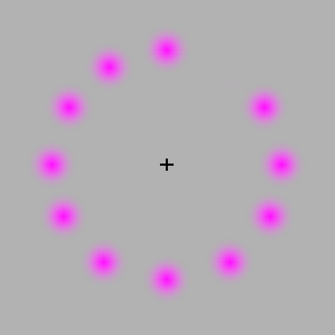
Stare at the black ” +”

